Slide 1




Impedance analysis of harmonic resonance in HVDC connected Wind Power Plants
Master Thesis Project
Igor Sowa
19 July 2016

Slide 2
Content
Introduction
Motivation
Model description
Converter models and other elements
Methods
Topology cases
Simulations results
Summary

Slide 3
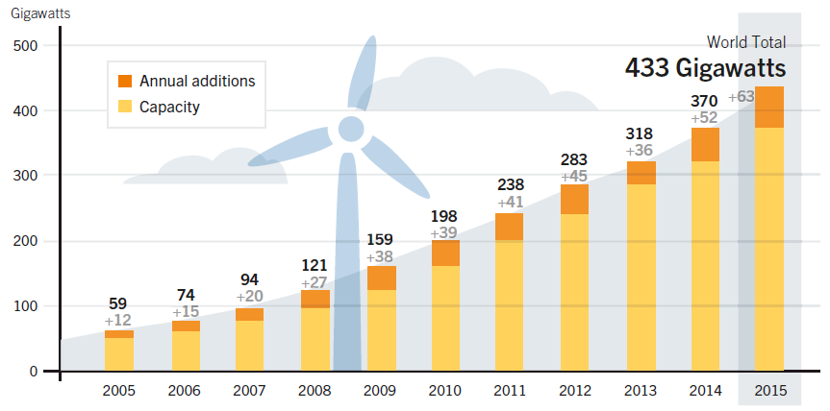
Introduction
Wind power capacity development
Figure 1: Wind Power Global Capacity and Annual Additions, 2005-2015. [1]
2015:
+63.7 GW (3.7%)
17.2% growth
The most incentives
Notes:
- Second RES, after hydro
- Wind power: 3.7% at the of 2015 global electricity production
- In 2015 largest annual increase ever: 63.7 GW (~43% of all RES) – growth rate of 17.2% comparing to 2014
- Record low prices for forthcoming RES in some countries due to policies and market frameworks

Slide 4
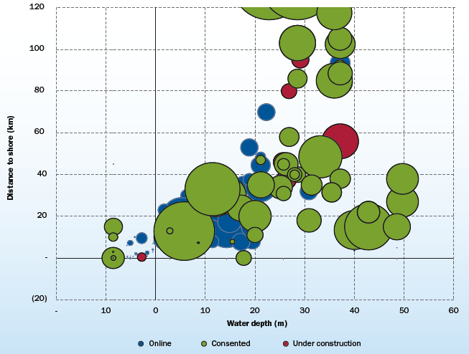
Introduction
Offshore WPP
12 GW total power
3.4 GW installed in 2015
3019 MW in Europe
Increase doubled comparing to 2014
Trends in technology:
Power of turbines
Water depth →
Distance from shore →
43.3 km in 2015 only
Figure 2: Average water depth and distance to shore of online, under construction and consented wind farms. [2]

Slide 5
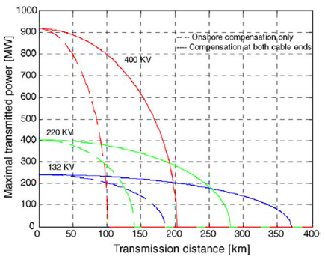
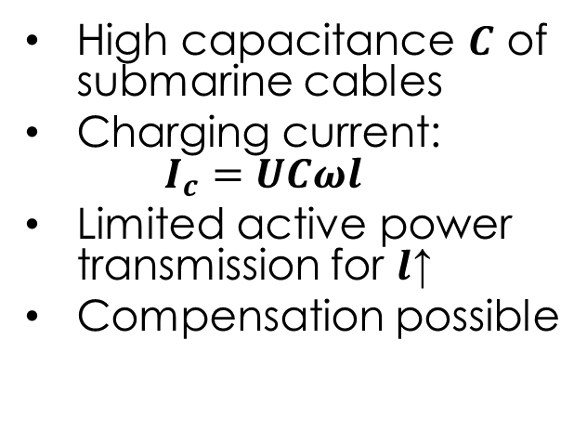
Introduction
Power transmission to shore
High capacitance $C$ of submarine cables
Charging current: $I_{c}=UCωl$
Limited active power transmission for $l$↑
Compensation possible
Figure 3: Maximal transmitted power by AC cables with and without additional compensation. [3]

Slide 6
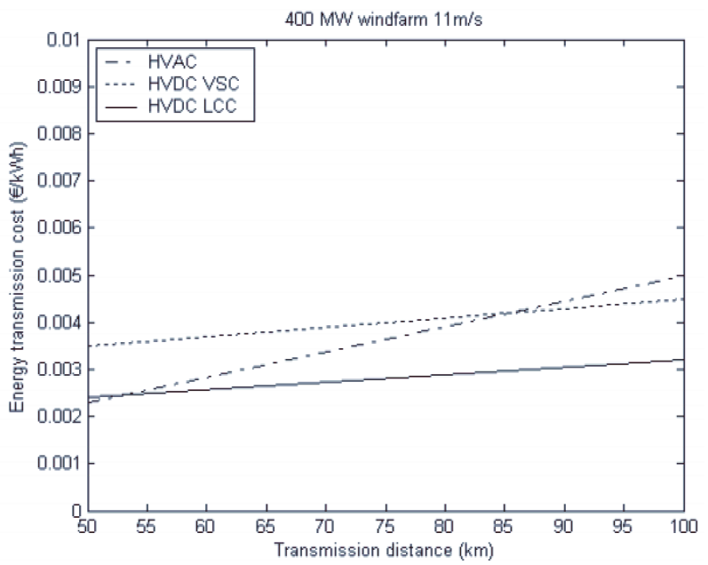
Introduction
HVDC transmission
No charging current – no compensation
Lower transmission losses
Cheaper and simpler cable
Higher controllability
Higher losses and risk of failure of converter
Should be decided on the project per project basis
55-85 km
Figure 4: Energy transmission cost for HVAC and HVDC technologies. [4]

Slide 7
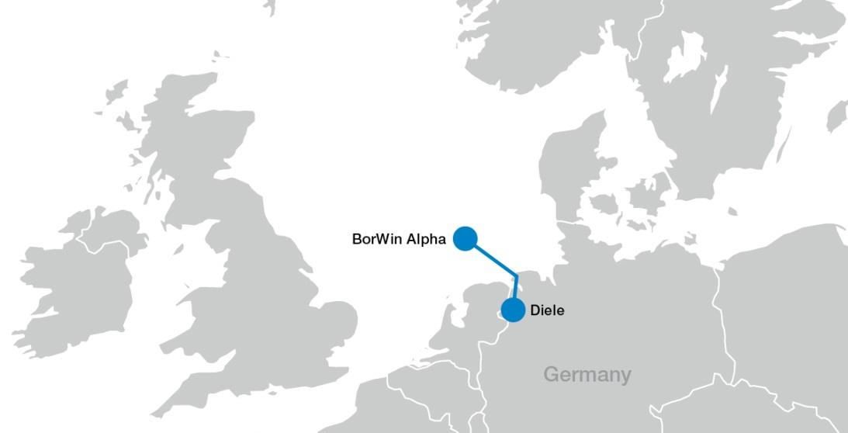
Motivation
Recent experience in operation of first HVDC connected offshore WPP
Phenomenon of harmonic resonance due to:
AC network with many cables bringing down the resonant frequencies
Limited damping due to power converter dominated grid decoupled from main AC grid (weak grid)
Necessity of harmonic resonance analysis for future project

Slide 8
Model description
Converter models
Methods
Topology cases
Modelling of other elements

Slide 9
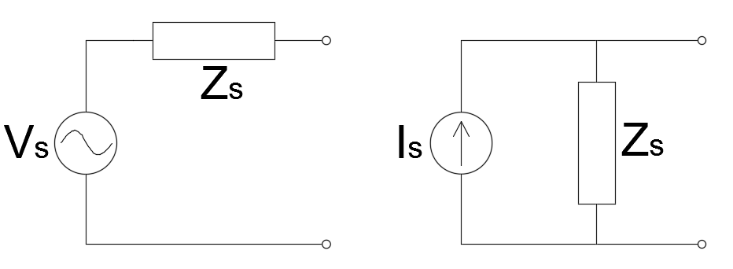
Model description
Converter models (I)
Importance of converter modelling
Difficulty in detail data obtainment
Model as either ideal voltage or ideal current source
Ideal VS becomes short-circuit in f domain
Ideal CS becomes open-circuit in f domain
Figure 5: Voltage Source and Current Source models.

Slide 10
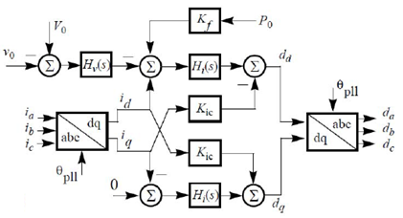
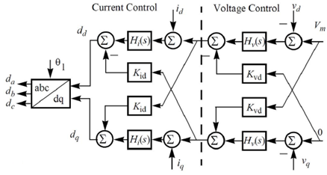
Model description
Converter models (II)
Nonlinear impedance models:
derived for WT inverter and HVDC-link rectifier
harmonic linearization method overcoming control nonlinearities
positive and negative sequences of impedance
valid below and above fundamental frequency
Figure 6: Control diagram of WT converter. [5]
Figure 7: Control diagram of HVDC converter. [5]

Slide 11
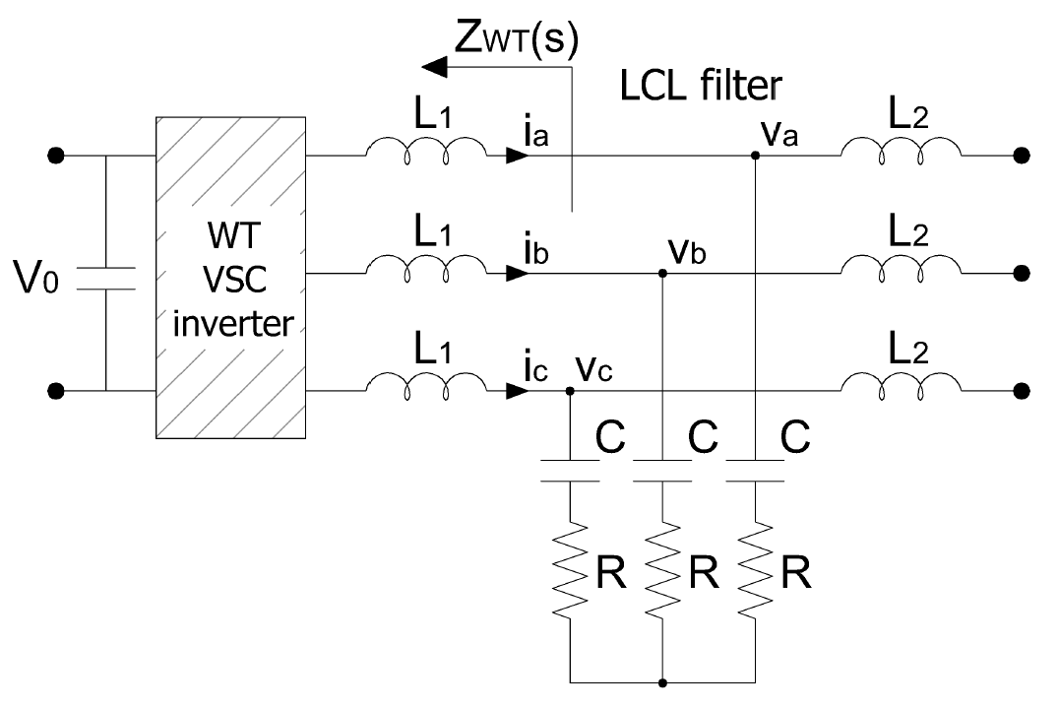
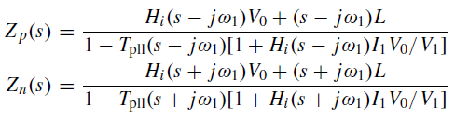

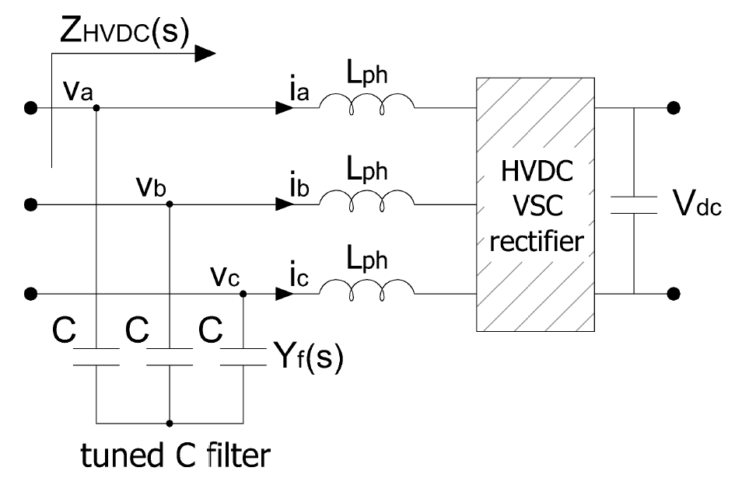
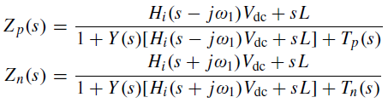

Model description
Converter models (III)
WT inverter [6]
HVDC-link rectifier [6]
Figure 8: Diagram of WT converter in the considered study case.
Figure 9: Diagram of HVDC converter in the considered study case.

Slide 12
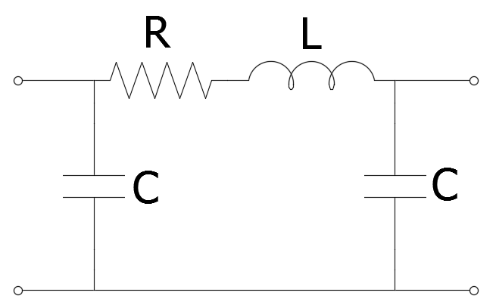

Model description
Modelling of other elements
Transformers – inductance L
Filter reactors – inductance L
Filter shunt capacitances – capacitance C with resistance R
Cables – π (pi) model:
Figure 15: PI model of cable.

Slide 13
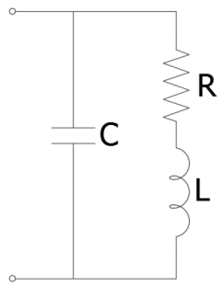
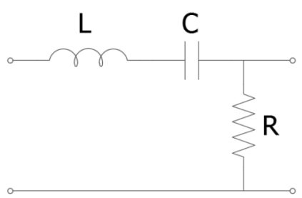
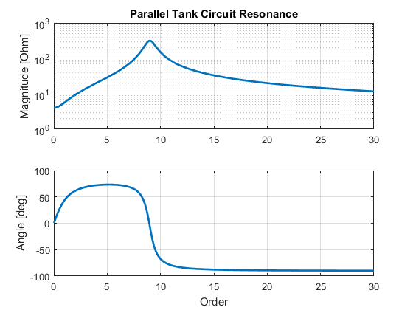
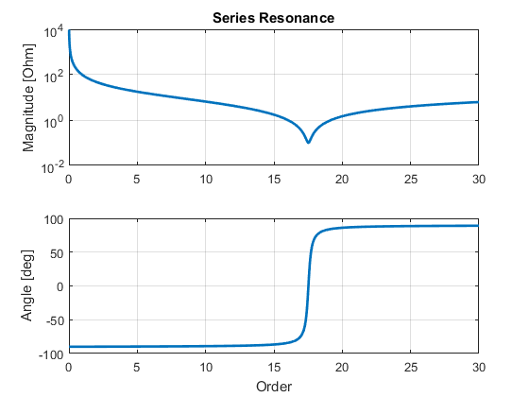
Model description
Methods (I): Frequency Sweep
Characterization of the system equivalent impedance at a bus in the system as a function of frequency
Figure 10: Parallel resonance example.
Figure 11: Series resonance example.

Slide 14
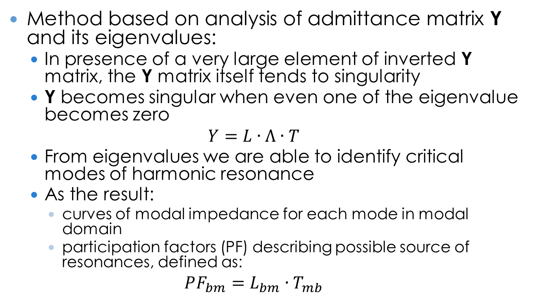
Model description
Methods (II): Harmonic Resonance Modal Analysis
Method based on analysis of admittance matrix Y and its eigenvalues:
In presence of a very large element of inverted Y matrix, the Y matrix itself tends to singularity
Y becomes singular when even one of the eigenvalue becomes zero
$$Y=L∙Λ∙T$$
From eigenvalues we are able to identify critical modes of harmonic resonance
As the result:
curves of modal impedance for each mode in modal domain
participation factors (PF) describing possible source of resonances, defined as:
$$PF_{bm}=L_{bm}∙T_{mb}$$

Slide 15
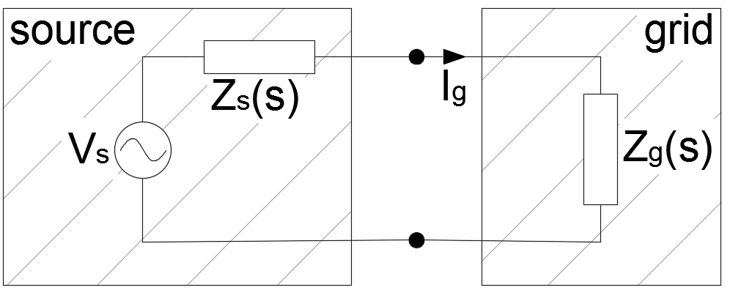

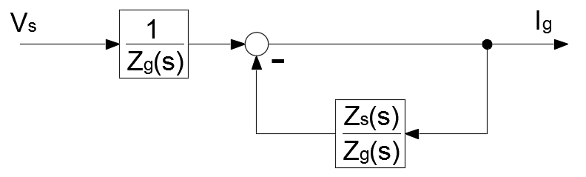
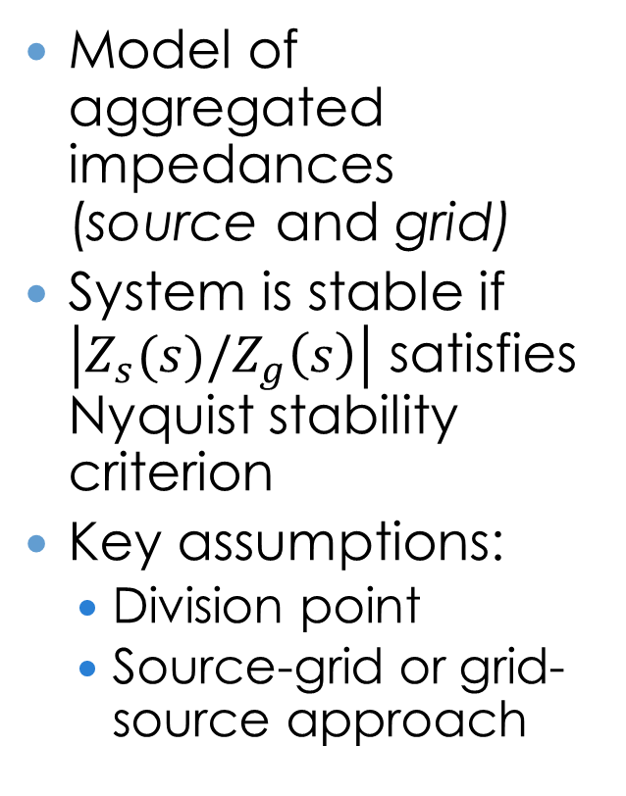
Model description
Methods (III): Stability analysis model
Model of aggregated impedances (source and grid)
System is stable if $\left|Z_{s}(s)/Z_{g}\left(s\right)\right|$ satisfies Nyquist stability criterion
Key assumptions:
Division point
Source-grid or grid-source approach
Figure 12: Impedance model for stability analysis. [6]
Figure 13: Closed loop system for stability analysis. [6]

Slide 16
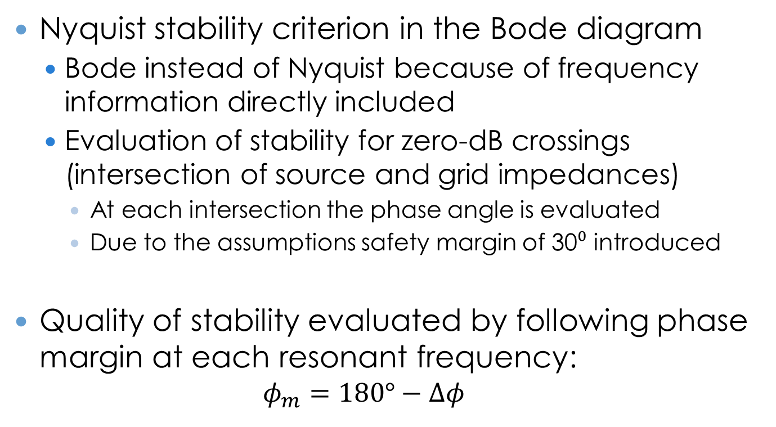
Model description
Methods (IV): Stability assessment
Nyquist stability criterion in the Bode diagram
Bode instead of Nyquist because of frequency information directly included
Evaluation of stability for zero-dB crossings (intersection of source and grid impedances)
At each intersection the phase angle is evaluated
Due to the assumptions safety margin of 30⁰ introduced
Quality of stability evaluated by following phase margin at each resonant frequency:
$$φ_{m}=180°−Δφ$$

Slide 17
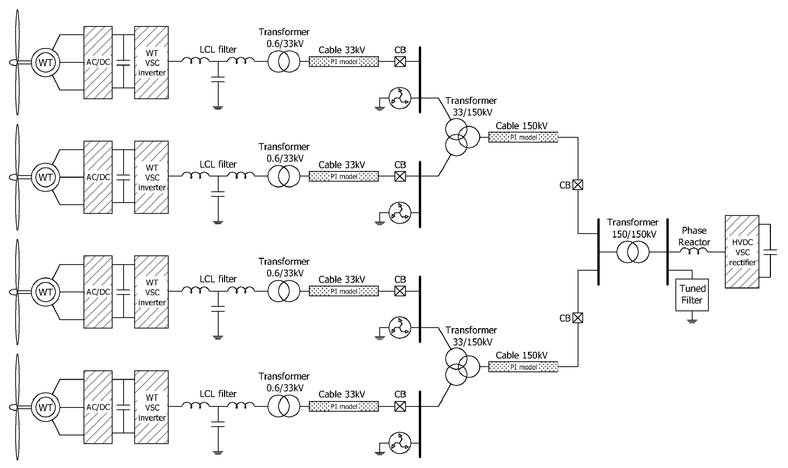
Model description
Topology cases
Case 1
Case 2
Case 3
Figure 14: Network of considered offshore WPP.

Slide 18
Simulation results

Slide 19
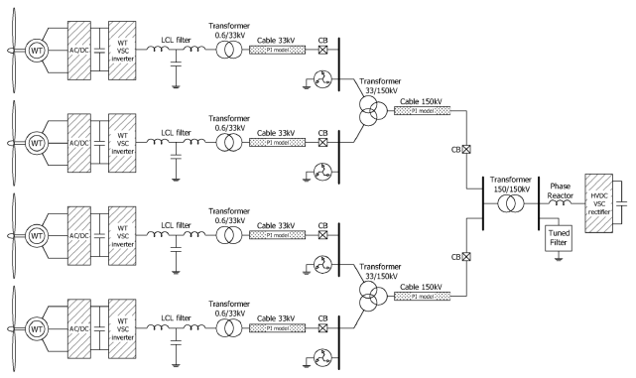
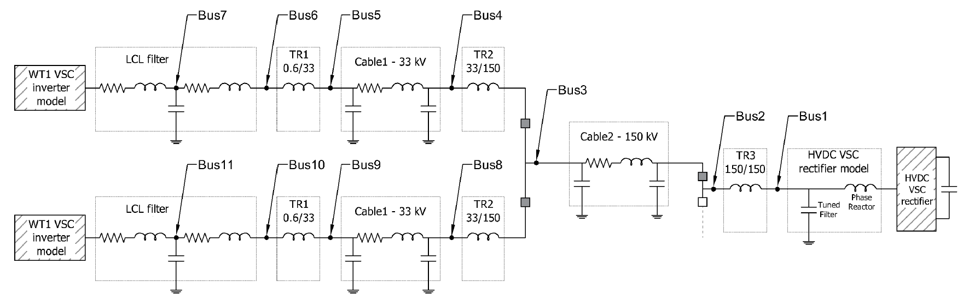
Simulations results
Impedance model
Software: MATLAB
Precision: 0.01 – 0.0001 order (0.5 – 0.005 Hz),
Range: up to 30 order (1500Hz)
150 kV equivalent circuit
Case 1
Case 2
Case 3
Figure 16: Impedance model of Case 2.

Slide 20
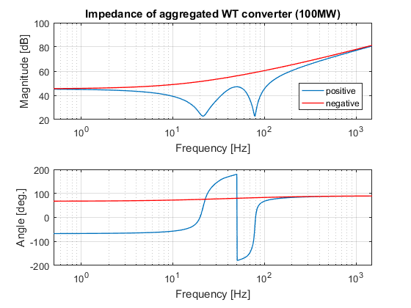
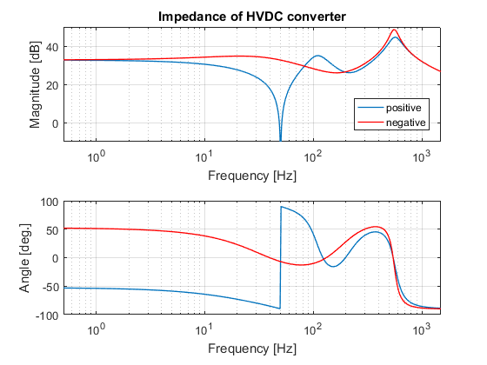
Simulations results
Nonlinear impedances of WT inverter and HVDC-link rectifier
Figure 17: WT inverter impedance
Figure 18: HVDC rectifier impedance

Slide 21
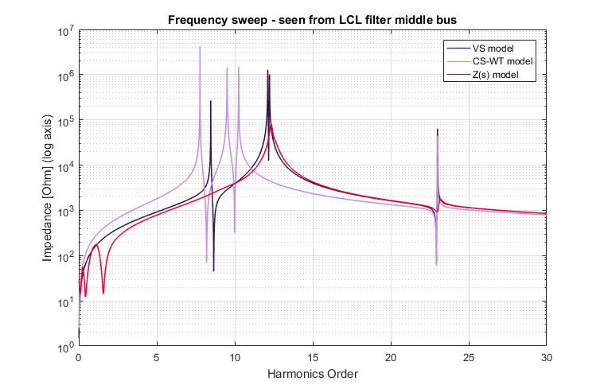
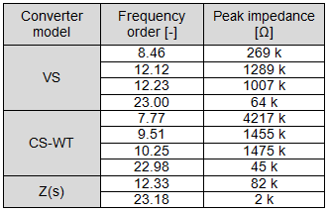
Simulations results
Case 2: Frequency sweep
Table 1: FS values of Case 2
Figure 19: Frequency sweep curves of Case 2

Slide 22
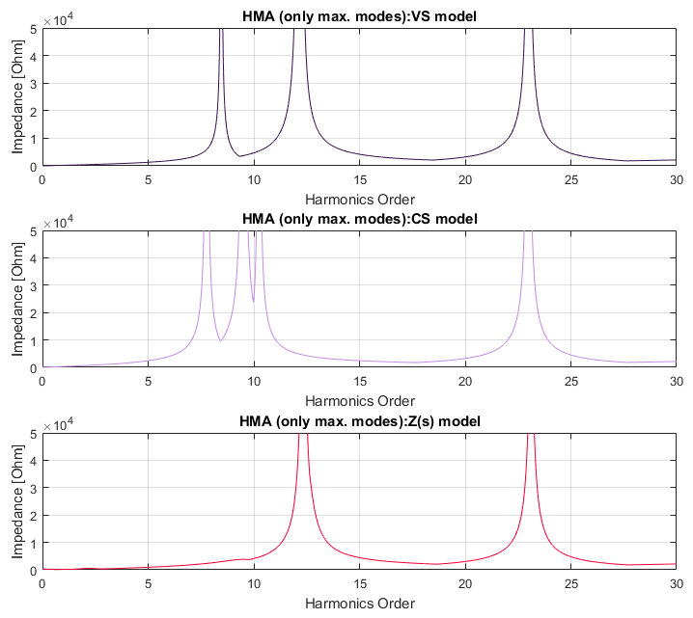
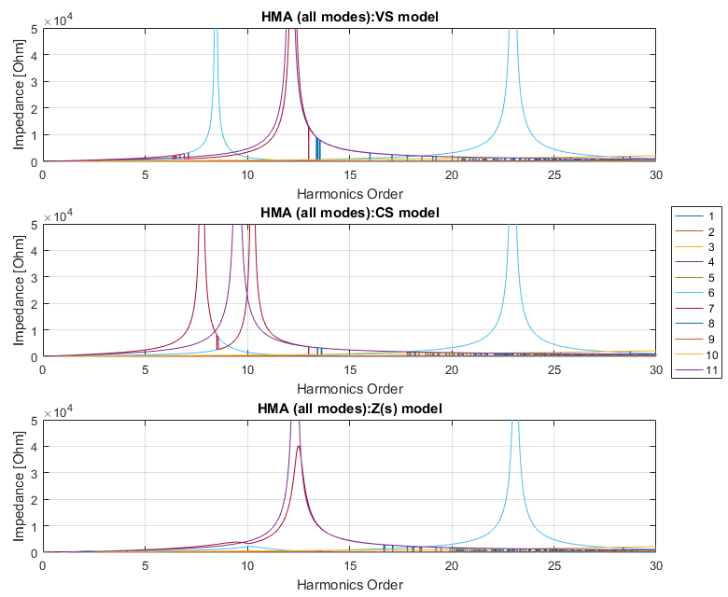
Simulations results
Case 2: Harmonic Resonance Modal Analysis – max. modes and all modes
Figure 20: HRMA - max. modes of Case 2
Figure 21: HRMA - modes of Case 2

Slide 23
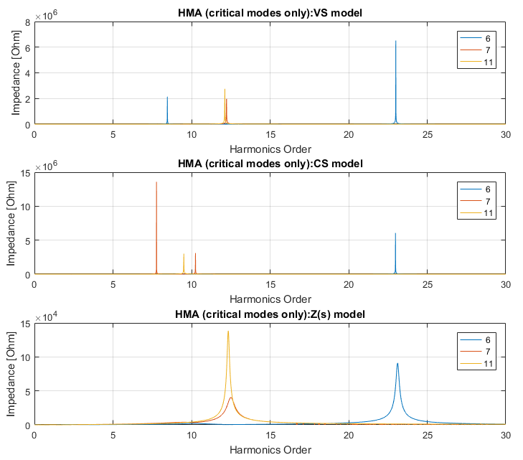
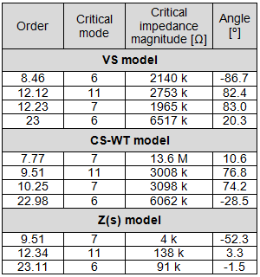
Simulations results
Case 2: Harmonic Resonance Modal Analysis – critical modes
Table 2: HRMA key values of Case 2
Figure 22: HRMA – critical modes of Case 2

Slide 24
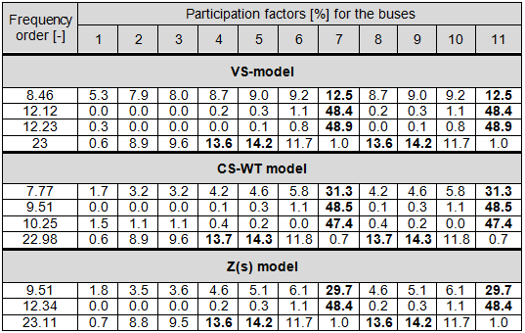
Simulations results
Case 2: Harmonic Resonance Modal Analysis – participation factors
Table 3: PF values of Case 2
Figure 23: PF distribution of Case 2

Slide 25
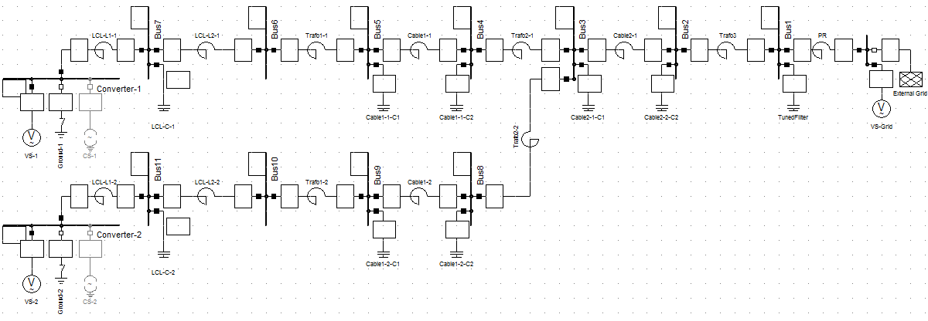
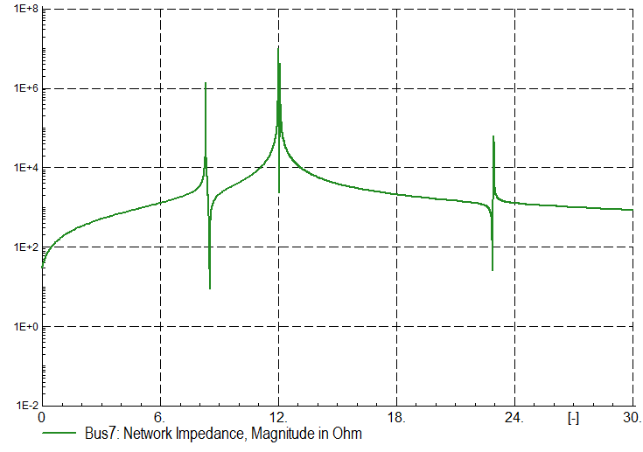
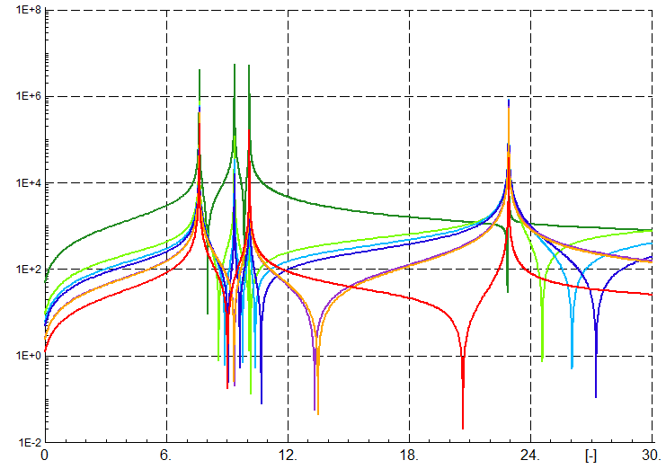
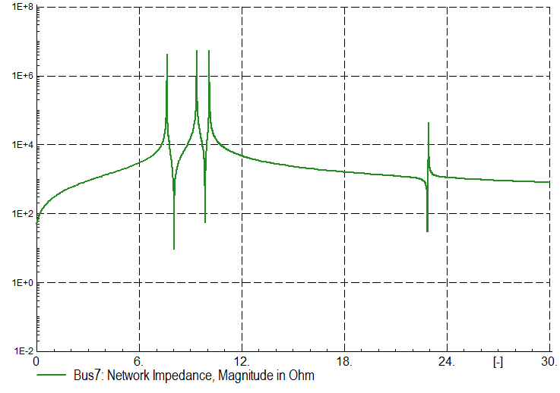
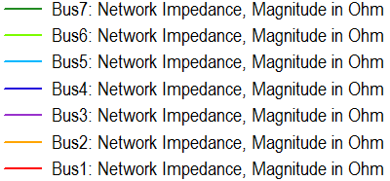
Simulations results
Case 2: Verification in Power Factory
Parallel resonance
Series resonance
Figure 25: Power Factory FS curves from multiple buses
Figure 24: Power Factory FS curves of VS and CS models – Case 2

Slide 26
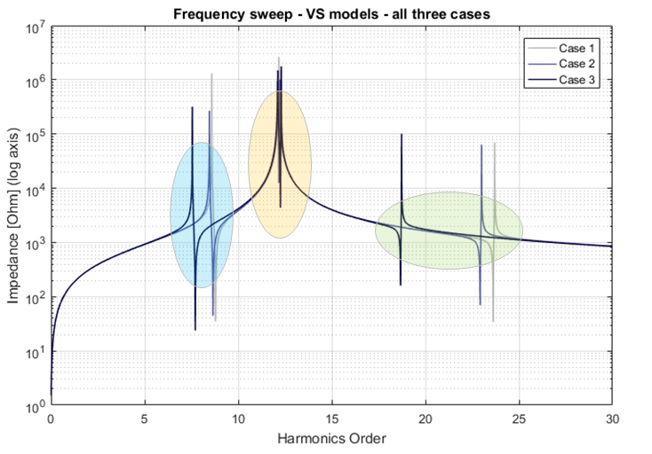
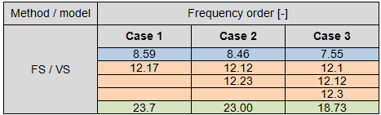
Simulations results
VS model: Comparison between topology cases by FS
VS model
CS-WT model
Z(s) model
Table 4: Comparison of FS values
Figure 26: Comparison of FS curves between topology cases – VS model

Slide 27
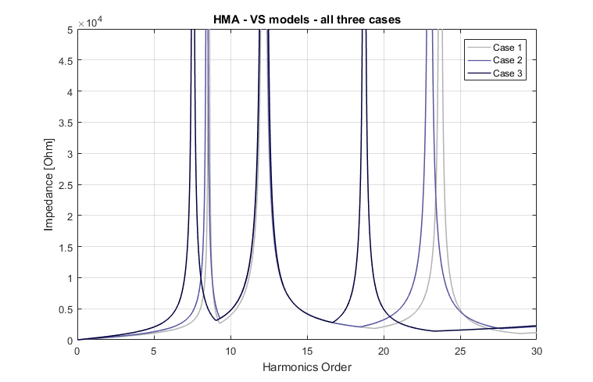
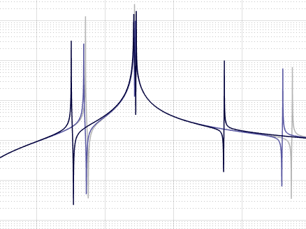
Simulations results
VS model: Comparison between topology cases by HRMA
Figure 27: Comparison of HRMA curves between topology cases – VS model
Notes:
Kolory

Slide 28
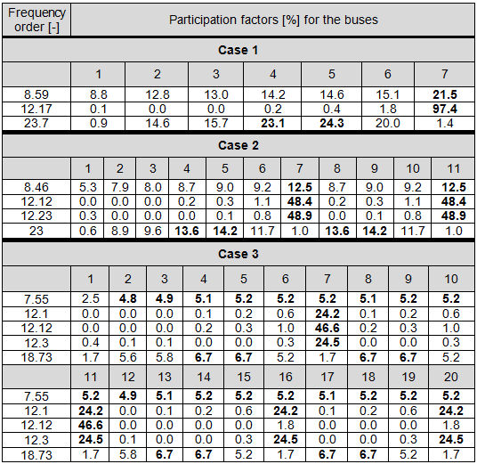
Simulations results
VS model: Comparison between topology cases: HRMA PF’s
Table 5: Comparison of FS values
Figure 28: PF distribution of VS model

Slide 29
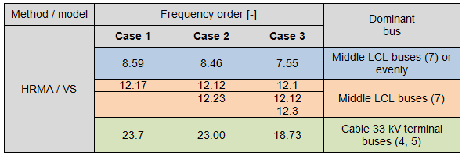
Simulations results
VS model: Comparison between topology cases: HRMA dominant buses
Table 6: Sources of resonances for VS model

Slide 30

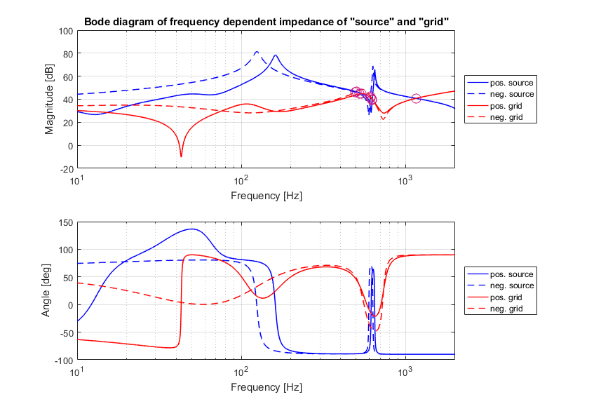

Simulations results
Case 2: Stability (I)
Figure 29: Bode diagram for stability analysis – Case 2

Slide 31
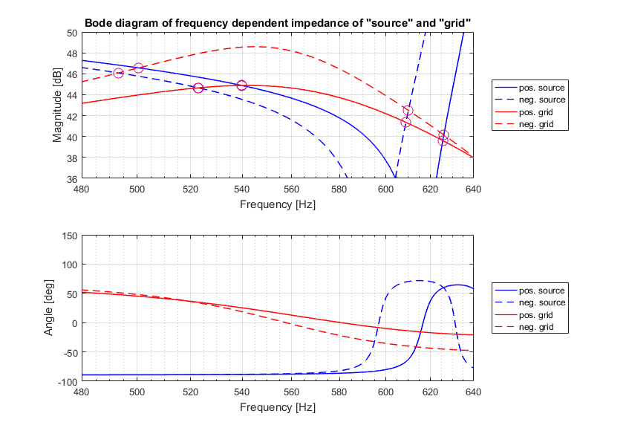
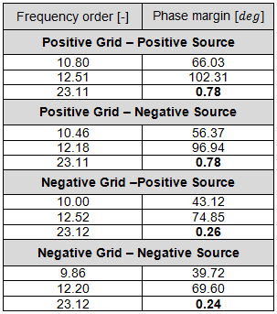



Simulations results
Case 2: Stability (II)
Table 7: Phase margins for each resonant frequency – Case 2
$$Δφ$$
Safety margin: $30°$
Figure 30: Bode diagram (zoomed) for stability analysis – Case 2
$$φ_{m}=180°−Δφ$$

Slide 32

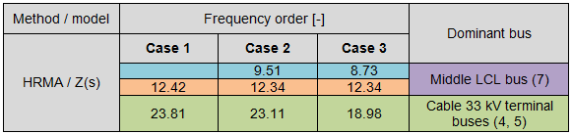

Simulations results
Z(s) model: FS vs. HRMA vs. Bode for all topology cases
Table 8: FS values for Z(s) model
Table 9: HRMA values for Z(s) model
Table 10: Bode diagram intersections for Z(s) model

Slide 33
Summary
Output from the methods
Table 11: Comparison of methods’ output
Method/ Output | Series resonance frequency value | Parallel resonance frequency value | Information about source of resonance | Information about stability
Frequency Sweep | Yes | Yes | No | No
Harmonic Resonance Modal Analysis | No | Yes | Yes | Yes, limited
Bode diagram | No | Yes | No | Yes

Slide 34

Summary
Observations from simulations
More resonant frequencies for cases with multiple branches
Downward shift of resonance for topology cases with more cables (more capacitance): $ω=\frac{1}{\sqrt{LC}}$
New resonant frequencies have expected values and expected source due to symmetry in the network
All three models are consistent with respect to sources of resonance
The resonance sourced near WT inverter is the ”stiffest”: minor shifting, highest PF’s and highest stability phase margin
Resonant frequencies of highest group (around 23th order) marked as unstable (unstable operation in case of presence of waveforms around this order)
Progressively worse stability phase margin for the topologies with more branches

Slide 35
Summary
Conclusions
Recognition of resonant frequencies, their values and amount in a network
Identification of origins of resonances indicating the best locations for filters implementation
Prediction of new resonances and their approximate origins in case of topology change
Labeling each detected resonances with respect to hazard for stability
Mitigation of resonance by adjusting of converter impedance (detailed control data necessary)

Slide 36

Thank you!
19 July 2016

Slide 37
Reference (figures, equations)
[1] REN21, „Renewables 2016 - Global Status Report. Renewable Energy Policy Network for the 21st Century,” 2016.
[2] EWEA, „The European oshore wind industry - key trends and statistics 2015,” February 2016.
[3] N. Barberis Negra, J. Todorovic, T. Ackerman, „Loss evaluation of HVAC and HVDC transmission solutions for large offshore wind farms”.
[4] G. F. Reed, H. A. A. Hassan, M. J. Korytowski, P. T. Lewis, and B. M. Grainger, „Comparison of hvac and hvdc solutions for oshore wind farms with a procedure for system economic evaluation," in Energytech, 2013 IEEE
[5] H. Liu and J. Sun, „Voltage stability and control of oshore wind farms with ac collection and hvdc transmission," IEEE Journal of emerging and selected topics in power electronics, vol. 2, no. 4, pp. 1181-1189, 2014.
[6] J. Sun, „Impedance-based stability criterion for grid-connected inverters," IEEE Transactions on Power Electronics, vol. 26, no. 11, pp. 3075-3078, 2011.

